Slide 1


What We’ve Won:
Knowing Your Collective Agreement
Staff Appointed Edition
Understanding your rights
Your career at U of T
Benefits
You and the Union
Updated Nov 27 2017
Graphic by Eugenia Tsao

Slide 2

Your Collective Agreement Rights
Over the course of five rounds of collective bargaining, we have enshrined and improved member rights in your collective agreement
Notes:
The agreement is important because it enshrines the terms and conditions of employment in a transparent document which everyone can read. The rules are clear, people are treated fairly and the union has recourse if it’s violated.
BUT, always remember, these are not gifts from a benevolent employer. They were obtained through struggle, and every round of bargaining we must fight to maintain and extend them. They can be taken away if members become disengaged, so don’t take them for granted
This is an overview of some frequently asked questions we get from our members

Slide 3

Overtime
If you work more than 36¼ hours in a week, you must be credited at time and a half
Remember to get your manager’s permission in writing prior to performing any OT Article 24:06-24:09
Stand-by and Call-in pay
TAKE YOUR VACATION
Article 17
Article 22
Notes:
Don’t work for free – U of T is built on unpaid “voluntary” overtime – too many of our members work through lunch, stay late or work from home, without being compensated for it. We all want to work hard and do a good job, but don’t allow yourself to be exploited. Come on time, work efficiently and effectively and go home and have a life.
Managers are not allowed to ask you to flex your time within the same week (ie. Stay late on Monday and in late on Tuesday)
Time and a half credit for overtime does not start until you have worked OVER 36 ¼ in the same week.
Authorized OT is credited to an overtime bank unless the employee and the immediate supervisor mutually agrees that the overtime is to be paid out.
Employees may take banked time as lieu time off, at mutually agreed to with the employee and immediate supervisor.
establish a process for overtime approval in exceptional circumstances when your immediate supervisor is not available to approve OT ahead of time. The OT bank may not at any time exceed 150 of total hours. At that point you should be paid for additional OT hours.
Departments are supposed to have procedures in place for OT approval in urgent situation when you can’t get pre-approval.
Employees authorized to work overtime beyond 9:00 pm will be provided with a taxi chit or reimbursed for campus parking.
Employees who are authorized to work overtime for 2 consecutive hours or more beyond their regular hours in a worked day are entitled to a meal allowance in the of $15
Stand-by and Call-in pay You are owed 2 hours of regular straight time pay for each evening on scheduled standby, 3 hours per day on weekends
Call-in Pay – minimum 4 hours at OT rate, or pay for all hours worked, whichever is greater. 2 hours OT if you complete the work from home
Vacation You need vacation to relieve stress, and ensure you stay on top of your game. You are only supposed to be able to carry over 5 vacation days plus your annual entitlement per year – after that you require management’s written permission.
Don’t let too many days accumulate or it may get clawed back upon cessation of employment.

Slide 4

Health Care Appointments
Article 13:14
You DO NOT have to make up the time to attend occasional doctor appointments
You DO NOT have to use vacation or personal days
Notes:
Many Managers and HR reps seem confused about what our collective agreement says and means
Occasional personal health care appointments should not be counted as a personal day, a sick day, or a vacation day. It also should not be counted as lieu time (i.e., time you have to make up later). Do remember, that the onus is on you to schedule your appointment outside of work hours or with a minimum of disruption.
13:14: Where an employee cannot schedule a health care appointment outside of the employee’s regular working hours, the employee will give as much advance notice as possible, and will be given time off with pay necessary to attend the appointment. In such cases, the employee will attempt to schedule the appointment so as to minimize disruption to the employee’s work day.
If you have regularly scheduled and frequent health care appointments, you may need to work out a flex time/accommodation arrangement instead. If you have a good relationship with your boss, you can work out something informally. If you don’t want to go this route, you should go to Health and Wellbeing. WITH THE NEW CONTRACT, you have the right to have a union rep help you with this.

Slide 5

Sick Leave
Up to 15 weeks paid sick leave per illness
Doctor’s notes
Health & Wellbeing
Long Term Disability
Accommodation/Return to Work
Article 27:01
Article 27:04
Article 20:06
Notes:
You do not have to work when you’re sick. Sick days are not work from home days. Inform your supervisor, put on your autoreply and go to bed. Don’t check your email and work from home.
After probation, you can take up to 15 weeks paid sick leave per year, per illness or injury. If you return to work for one full day between illnesses, you get another 15 weeks for any new illness. For recurring illnesses, you must be back at work for 3 months to qualify for an additional 15 weeks. If your sick leave extends beyond 15 weeks, you must apply for Long Term Disability, which pays 70% of your salary
Sick days are not banked if you don’t use them, like in some contracts. They’re there if you need them. Probationary employees only get 3 sick days.
-Even documented sick days can result in coaching letters, or even termination if the University can claim undue hardship and frustration of contract. Don’t abuse sick leave! Use it when you need to (but don’t try to be a hero by coming in and making your colleagues sick).
Sick days are for when you’re sick. Personal days (four per year) are for when your kids or other family members are sick.
File medical documentation with Health & Wellbeing after an absence of 10 days, do not disclose confidential medical information to your direct manager.
manager’s can ask for a doctors note, but this is not consistent across the university
If you have been on a sick leave and are invited to attend a return to work meeting with management and HWB, DO NOT attend without a union rep. The union will ensure your return to work plan is in line with your doctor’s recommendations.

Slide 6
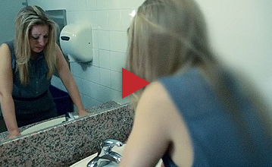
Bullying & Harassment
  It is management’s responsibility to provide a workplace free from bullying and harassment
  USW Mediation Service for Member-on-member Conflict
Article 3:06 & LOI (pg. 74)
  Know the signs and get the facts & resources you need: http://notinmyworkplace.com/
  Familiarize yourself with the
  U of T Civility Guidelines
Notes:
One of the most common complaints we hear
Bullies prey on those they deem to be weak. Don’t be silent, challenge harassing behaviour immediately. Demand that it stop. If it doesn’t, talk to your union rep and file a complaint.
U of T civility guidelines list things like: Shouting, profanity, abusive, aggressive or violent language / Slamming doors / Humiliating, degrading, demeaning, belittling, insulting, frightening or intimidating another person / Telling inappropriate jokes, etc
This is not acceptable behaviour and you don’t have to put up with it. Many members endure bullying for years without taking any action and only come to the union when they’re in need of sick leave for stress/mental illness. You can contact the union confidentially any time for advice and assistance. If you choose to file a complaint, we can support you through the process.
Stand up for your co-workers too! If you witness bullying behavior or unjust treatment, intervene or contact a steward.
Member-on-member Conflict: Not getting along with a colleague? Think twice before complaining to management; utilize the USW Mediation Services –- non-punitive means to resolving the problem without assigning blame - reporting member on member conflict to management can lead to discipline/coaching – trying to solve it in-house before it escalates is in everyone’s interest. Management and HR intervention can sometimes make a situation worse.

Slide 7
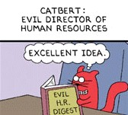
Disciplinary &
Coaching Letters
You have the right to have a union steward present for disciplinary meetings
Discipline remains in your file for 2 years
“Coaching” letters are non-disciplinary and remain in your file for 12 months of active employment
Article 10
      You have the right to view your personnel file with a union steward present
Article 32:01
Notes:
Members often ask us if they have to go to a meeting with management. Management has the right to meet with their staff at any time. If the meeting is disciplinary, then you have the right to a union rep. You don’t have the right to a union rep in an investigation meeting, but often management will allow it.
-A written letter you receive regarding your performance that’s not referred to as discipline is a “coaching letter.” NEW CONTRACT These letters remain on your personnel file for 12 months. Subsequent ones may result in discipline or even termination. They can be a real problem with reference checks and impact career development.
You can grieve to get illegitimate letters removed from your file (or edited, or establish a sunset clause) by arguing management rights are being used in bad faith (Article 4). Now that coaching letters have a sunset clause, we won’t be grieving them as vigourously, but will mainly focus on those with factual errors and misrepresentation.
If you have an old coaching letter in your file, contact your HR generalist and ask to have it removed. They are supposed to be systematically going through files, but it’s good to check for yourself to make sure it’s done.

Slide 8
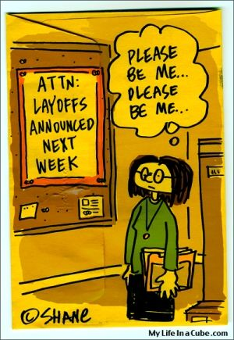
Organizational Change
Articles 12:05-12:14
Org Change is the most common way members lose their jobs
Redeployment Pool or Enhanced Severance
U of T Career Transition Services
Grieving an improper org change
Notes:
Management does have the right to cut and change jobs. The union can’t stop lay-offs, but we have bargained a safety net to catch you, including improvements in the new contract. You will get 6 weeks’ notice of organizational change, followed by 12 weeks notice of lay-off, for a total of 18 weeks. A union rep will meet with you after you get your notice to answer your questions.
- You go immediately into the redeployment pool, which can give you up to 18 weeks to find another job before your laid off. Redeployment gives you priority for other U of T jobs at your payband or lower.
-You have first dibs on any new positions created in dept. via org change, provided you meet the minimum qualifications (and it’s at your payband or lower)
You then have a chance at any new vacancies in the dept which result from people moving into the new positions
If at the end of your notice period, you haven’t found another job, you can opt to stay in redeployment for 24 months or take termination and enhanced severance.
Some people do very well in redeployment, others struggle. Members have reported problems such as discrimination, few continuing positions at their payband, etc – in redeployment, you need to be QUALIFIED for the job – not the most qualified. In the new contract, and HR rep will be in all job interviews with a redeployment candidate and you can ask for feedback afterwards.
The union has negotiated a $250K annual Pathways to Employment Fund which will support training and development needs for redeployment pool candidates. We’re still in the process of getting this off the ground.
-U of T Career Transition Services (career counseling, computer skills upgrade, training support, resume prep, external job search support) - are excellent – use them – you get 7 days during lay off period for job search. You can now also have HR give you a skills assessment.
- We do grieve improper org change – if the work really does still exist, if they’ve created a new job that looks exactly the same, if they’re replacing the work with casuals or contracting out, etc. In the new contract, the union now has the right to grieve an org change before the member is notified. We do fight these and win settlements for our members, but we are VERY unlikely to get your old job back
-if you are grieving, not applying for new jobs created by the org change, or taking the severance, will hurt your chances. You have a duty to mitigate your losses.

Slide 9

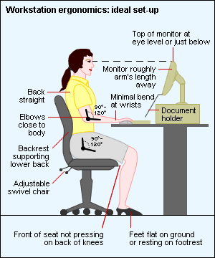
Health & Safety
If you sit at a desk all day, learn about ergonomics.
Environmental Health & Safety Website
Right to refuse unsafe work
Incident Reports
WSIB Claims
Health & Safety Committees
Mark Austin, the USW1998 Health & Safety Officer
Notes:
-Carpal tunnel can be caught early & corrected. Talk to your doctor & manager if you are experiencing pain, get an ergonomic assessment, & file a workplace injury report
-Consider switching to a Trackerball and ergonomic keyboard
-If you injure yourself at work, make sure an incident report gets submitted for a WSIB claim – even if you don’t think it’s a big deal, it could become a problem later
-If you are interested in health & safety issues, join the health & safety committee
- If you have questions, you can contact your local joint health and safety committee rep, or contact our union Health and Safety Rep Mark Austin

Slide 10
Your Career at U of T

Slide 11
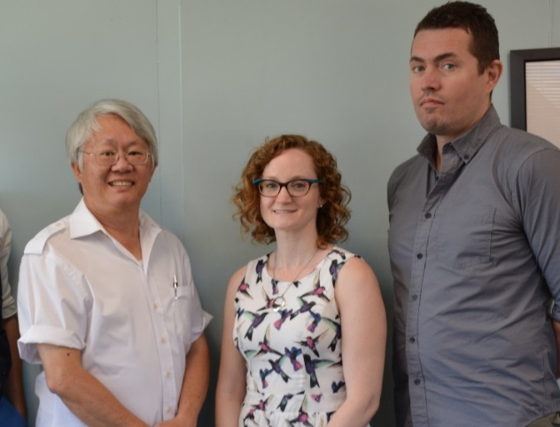
Job Evaluation
A joint system to implement pay equity and internal equity in USW jobs
If you’re in a new job, fill out the questionnaire
If your job changes and you believe your pay doesn’t reflect the changes, contact the JE team
Manager-Initiated or Employee-Initiated Reclassification
Our Job Evaluation team
P.C. Choo, Kim Walker, Jan Eichmanis and
Mary-Marta Brione-Bird (not pictured here)
Notes:
Job Evaluation is far from perfect, but it does allow for a joint system where the union has the opportunity to review jobs to make sure they’re rated fairly AND to advocate for members for a reclassification if their job changes.
Do the questionnaire after being in a newly created position after six months
If your job has CHANGED, you can ask for reclassification –increased workload does not count – change in duties – responsibilities, skills, effort - does
If your manager is on board, you can go with a manager-initiated reclass. If your manager is not, you can submit an employee-initiated reclass.
Either way, consult with the JE team for advice and information before plowing ahead.
If you aren’t careful, your job could get reclassified to a LOWER payband! Call the union and book an appointment with JEC staff.

Slide 12
Internal Job Postings
Article 12:04
Internal job postings at the Careers at U of T website
Qualified internal applicants will be interviewed
The University must demonstrate they hired the most qualified candidate
Flexible options
  Secondments
  Two month trial period
Notes:
-Get email notices of internal job postings that match your Candidate Profile interests. Sign in to the Careers at U of T website with your UTORid and password
don’t trust the email notices – jobs get missed, so check regularly
you can apply for jobs on the USW internal board. NEW CONTRACT, you now have a second chance to apply to jobs on the external board, although you don’ have special status. (website has not been updated yet).
NEW CONTRACT – job notices will have more information on the job duties.
NEW – internal applicants who meet the minimum qualifications will be interviewed. You’ll be notified of the outcome of the search before the successful person starts.
You don’t need to use personal, vacation or flex to go to an interview. You DO need to tell your boss that you’re going. If you want to keep it on the downlow, then you do need to take a personal or vacation day.
You should be aware that you do need to list your current supervisor on the application form at the interview. There’s no way around this, so your boss will find out that you’ve applied. If you think your boss will give you a bad reference, you still need to put them down and management retains the right to contact them. You should tell the HR generalist that you don’t think your current supervisor will give you an accurate reference and that they should rely on the other ones for a better picture.
When requested, HR will meet with qualified applicants who are unsuccessful in competition to assist with career development plan and job search skills
You can file a failure to hire grievance if you’ve been passed over for a job and you know that you were well-qualified for it – tough to win
-The University retains discretion to post externally after qualified internal applicants have been interviewed
You have options to try out other jobs
- secondments – can return to your job (if it still exists) – if there’s an org change while you’re on secondment, those rights kick in
- two month trial period

Slide 13

Advance your Career Goals
Subscribe to the ODLC Listserv! The Organizational Development & Learning Centre (ODLC) offers lots of great training opportunities, career services, info sessions on work-life balance, etc.
Career Community
  job application, career and networking resources
Notes:
U of T is a big place, and there’s lots of opportunities to work different jobs if you’re not fully satisfied with your current one (or your manager’s a jerk)

Slide 14

Benefits
The Union has negotiated many benefits for our staff appointed members over the years, so take advantage of them!

Slide 15
Leave Options
Letter of Intent pg. 68
Self-funded leave
Unpaid Leave of Absence
  For up to 1 year, with possibility of extending a further 6 months with no loss to seniority
Parental Leave
  17 week pregnancy leave + 35 weeks maternity leave
  37 weeks parental leave for all other parents (includes
  adoption, custody)
Articles 13:02 & 13:03
Articles 13:06-13:10
Notes:
Self Funded Leave - Employees with 3 years of service can apply for a leave of absence for 3-12 months with the option of deferring a portion of your salary
Must apply at least 6 months in advance
Unpaid Leave of Absence - Can continue benefits coverage if you prepay. Must apply at least 4 weeks in advance
Training to be provided upon return from leave if necessary. BUT – be careful. If your boss has it out for you, they may use your leave as an opportunity to re-org you out of a job! Remember, you can only return to your position if it still exists.
NEW CONTRACT There are changes to maternity leave as a result of EI changes, which should be implemented in late 2017 or early 2018. You will have the option of extending your EI up to 18 months and U of T will stretch out its top up for a longer period. None of the details have been set up yet, so liaise with the Family Care Office for up to date information.

Slide 16


Tuition Waivers
Educational Assistance (pg. 58-59)
For staff, degree course waivers are limited to 3.0 full courses during Fall/Winter and 1.0 course during Summer session.
Staff can get up to a PhD (flex/part-time). For graduate level studies, tuition waiver is limited to part-time program fee or $3000 per academic year (whichever is less)
Notes:
-Yourself and dependents (who don’t already have a BA) only have to pay ancillary/incidental fees
-Reimbursement is limited to equivalent general Arts & Science course tuition fee (you will have to pay additional for professional programs)
- You must get your boss’s sign off if the course is during work time

Slide 17

Other Education Options
Non-credit Degree program (requires enrollment)
Continuing Studies Courses
50% reimbursed tuition upon successful completion of job-related course at another “recognized educational institution”
Public lectures, course auditing
Notes:
NEW CONTRACT -Continuing Studies Courses – U of T will pay up to $750 per course if work related, $350 for personal interest (max 4 courses per year).
- Get permission first and find out if your course qualifies before going with the 50% reimbursement
- Not keen on committing to more school? Attend public lectures, or sit in on some of the big introductory classes in Con Hall (ANT 100, PSY 101). Many profs will allow you to audit course if you ask permission (no enrolment necessary)

Slide 18


For Your Family
Child Care Benefit Family Care Office
Part-time Status for Family Care
Compassionate Care Leave
Appendix C (pg. 83)
Article 24:11
Article 13:15
Notes:
Child Care Benefit - Staff with children under age seven can be reimbursed for childcare costs, up to $10 per half-day or $20 per full day, to a max of $2000 per year, per child. Apply via ESS
Family Care Office - All kinds of family-friendly events, parenting and elder care workshops, peer-mentorship program – even an online Babysitter Directory
- Info sessions on mat leave benefits

Slide 19

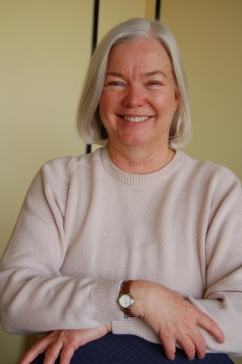
USW Benefits
Steelworkers Dental Office
  15% discount on last year’s Ontario Dental Assoc. Fee
USW Scholarships
Injured Workers Program
Steelworkers Lifeline Foundation
Discount programs
Steelworker Dental Staff at 33 Cecil St.
Sharon Clarke,
Lifeline Coordinator
Notes:
Dentist – two locations
33 Cecil St. T. 416. 343. 0086
1158 Aerowood Dr, Mississauga T. 905-238-1414
Injured Workers Program - Advocacy, confidential advice and information on workplace injury, disability and workplace accommodation and rehabilitation
Scholarships – for you and your kids
Post Secondary School Scholarship
Lifelong Learning Scholarship
David Ellis Scholarship
Rudychuk Scholarship Placement Program
Steelworker Summer
District 6 Scholarships
Lifeline - Employee Assistance Program provides confidential info, referral, and support services for members and their families struggling with personal and work issues (addiction, debt, mental illness, divorce, etc.)
An alternative to the University’s EFAP Program (remember Homewood is a client of the University; it’s best to use Lifeline if you are dealing with a bully manager).
Discount programs
Home and auto insurance
Tourist attractions
Union Savings

Slide 20
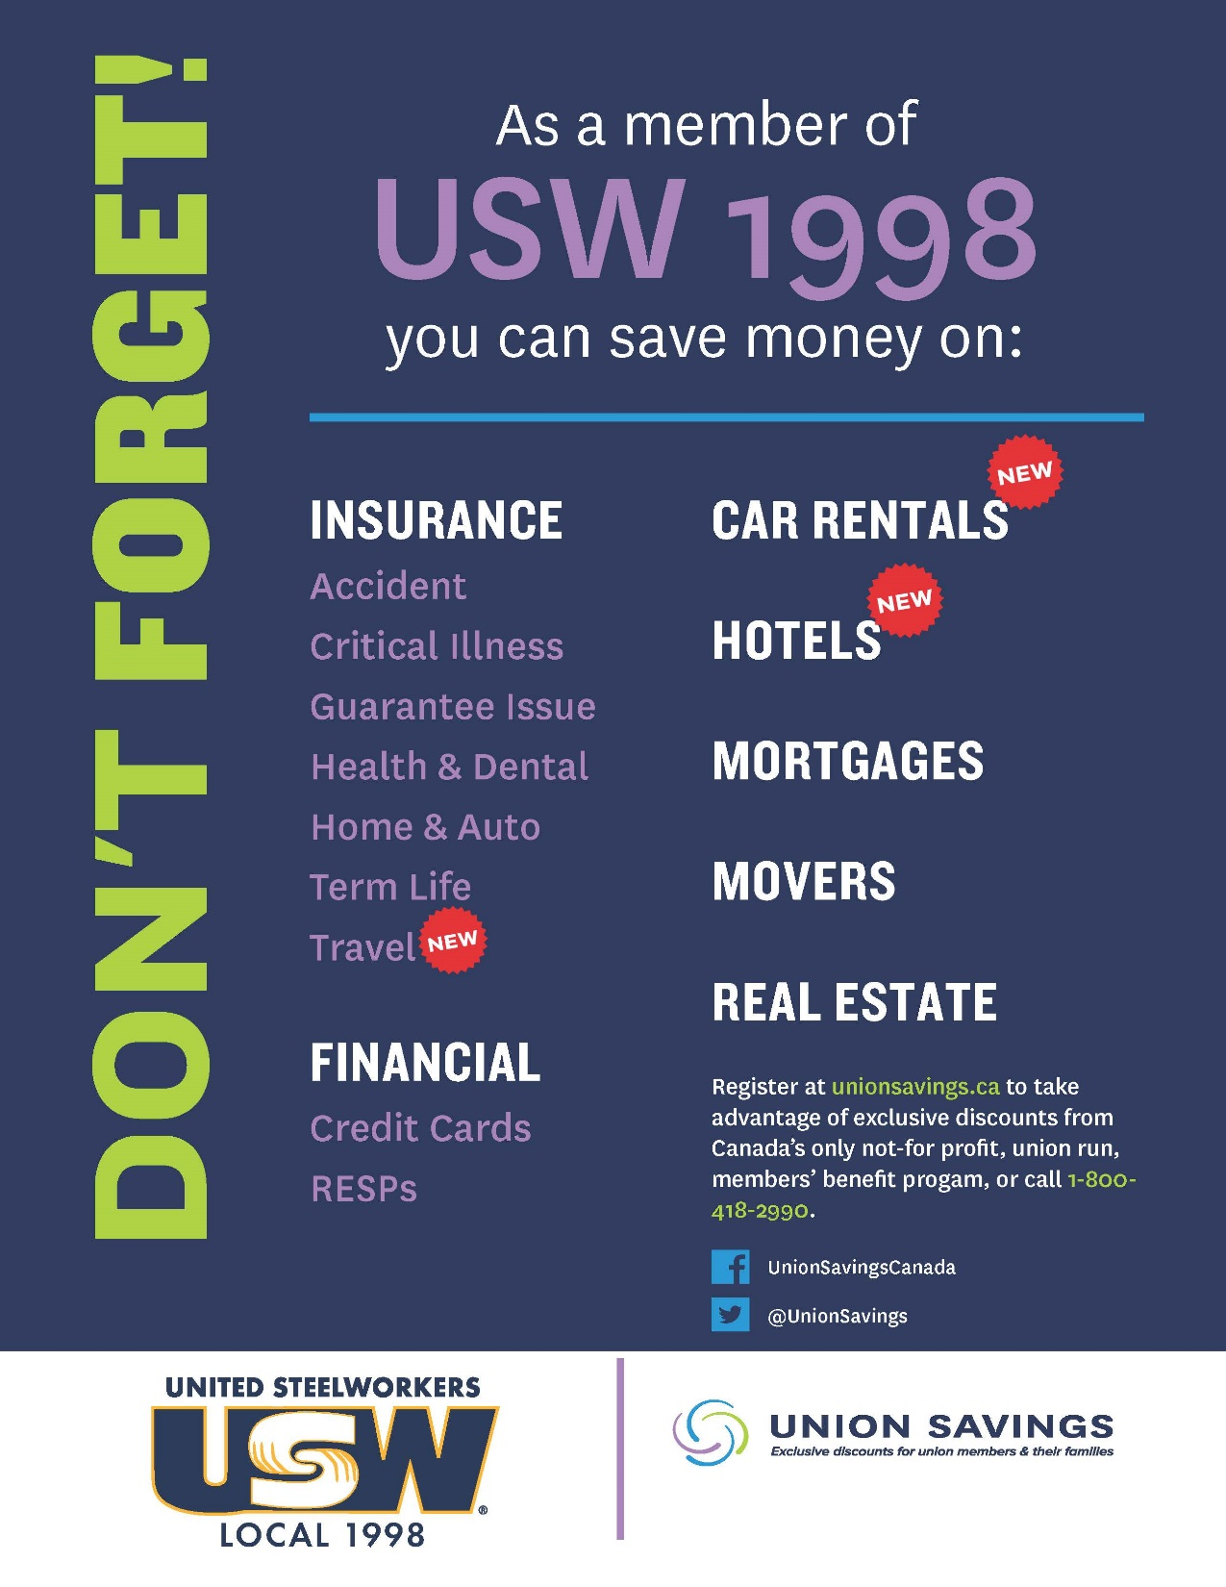

Slide 21
You and Your Union
Information
Representation
Participation

Slide 22

HR is NOT Your Friend
Although they may give you useful information about pay and benefits, ultimately they work as agents of the system (or university) - like Agent Smith from The Matrix.
If you have a problem, contact your union FIRST.
Notes:
A note on representation - HR works for management, they are not a neutral referee between management and employees, which is what many members think. If you are in a situation where you’re being disciplined, it’s HR on the same side of the table as management. You can go to them with questions about pay and benefits, but if you have a workplace problem, contact the union first.

Slide 23

You are the Union
The Union is only as strong as its members, so activism is key!
Get involved on a local committee that interests you.
  CAT (Communication Action Team)
  Communications/Steeldrum Newsletter
  Health and Safety
  Human Rights
  NextGen
  SteelPride
  Women of Steel
Become a Steward
Notes:
Participation
Come out to meetings like this
Monthly membership meetings
Join a committee
Look out for educational opportunities
Vote!!! Get involved in bargaining campaigns
We can’t win good collective agreements or grievances if the University thinks the Union doesn’t have strong support among members

Slide 24


Stay in Touch
416. 506. 9090
info@usw1998.ca
jec@usw1998.ca
www.usw1998.ca
Facebook.com/groups/USWLocal1998
@usw1998

