Slide 1

Detoxify your workplace
Standing Up to Bullying & Harassment at the University of Toronto
A USW1998 Workshop

Slide 2
Workplace harassment
Engaging in a course of vexatious comment or conduct against a worker in a workplace that is known or ought reasonably to be known to be unwelcome
Notes:
Translation: “doing nasty things you know are nasty to a co-worker who doesn’t want it. And even if you said you didn’t know it was nasty, you still wouldn’t be excused, because any reasonable person would know it was nasty!”

Slide 3
Civility guidelines
CIVIL CONDUCT INCLUDES | BREACH OF GUIDELINES
Treating others with dignity, courtesy, respect, politeness and consideration | Shouting Profanity, abusive, aggressive or violent language directed at an individual or individuals
Speaking in tones of voice that are appropriate for the circumstances | Using props suggestive of violence Slamming doors Throwing Objects
Being respectful of others’ right to express their views, even if you disagree | Humiliating, degrading, demeaning, belittling, insulting, frightening or intimidating another person
Managing conflict with others in a respectful way rather than a confrontational way | Distributing comments about a person that are unjustified and likely to have a negative impact if they were to see them
 | Telling inappropriate jokes
The University of Toronto’s Human Resources Guideline on Civil Conduct constitutes the Workplace Harassment Program as required by the Occupational Health & Safety Act
The guidelines describes what constitutes civil and uncivil conduct, and sets a framework for filing civility complaints
Notes:
-See also the Guideline for Employees on Concerns and Complaints Regarding Prohibited Discrimination and Discriminatory Harassment; Policy on Sexual Violence and Sexual Harassment; Policy with Respect to Workplace Harassment; and the Workplace Violence Program and Policy.
-In reality, we rarely hear from members who have evidence of discrimination based on the prohibited grounds covered by the Human Rights Code, and the University takes such complaints very seriously due to liability concerns.
-Our members more frequently experience incivility, bullying, and harassment that isn’t necessarily discriminatory in nature. Much of it is discrete, insidious, and difficult to prove. (insidious means proceeding in a gradual, subtle way, but with harmful effects; treacherous, crafty).
For this reason, we are going to focus today on filing complaints under the Civility Guidelines, since they are the most common violated and hence the most common type of harassment complaints the union is involved with helping members on.

Slide 4

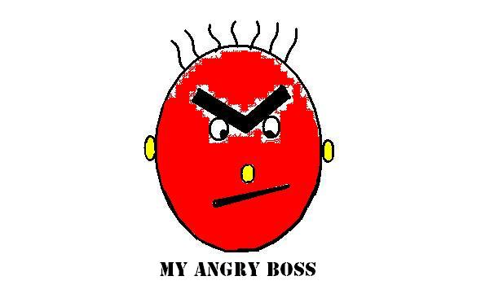
not examples of uncivil conduct!
REASONABLE management actions, such as meetings, letters, or conversations re: performance management, attendance, coaching
Instructions given by supervisor/manager re: what to do, how to do it, expected standards of performance
Disciplinary action
Denial of leave requests
Requests for documentation to substantiate leave requests
Comments made in the context of peer review processes
Differences of opinion or debate conveyed in a RESPECTFUL manner
Interpersonal conflicts where the parties remain RESPECTFUL of one another.
Notes:
-Management has rights as per article 4. They have the right to run the workplace as they see fit; they have the right to make stupid decisions and be incompetent, as long as they don’t violate the collective agreement, labour legislation, the civility guidelines or other U of T policies
-Unreasonable management actions can often be taken up as grievances, if the collective agreement has been violated, i.e. unreasonable denial of a vacation or leave request, unjust discipline, etc.

Slide 5
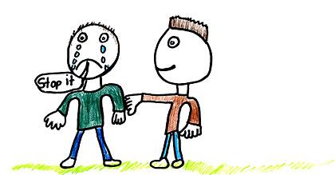
If you have a complaint
STICK UP TO THE BULLY
CONSULT WITH THE UNION
You must make it known to the bully that their behaviour is unwelcome and negatively affecting you
Stick up for your colleagues too. If you see bullying, call it out, name it, demand that it stop
But remember there is a fine line between appropriate assertiveness, defending your rights, and insubordination
Especially re: member on member conflict, going to management or HR may result in punitive action
SIMS (Steelworker Internal Mediation Program) for non-punitive conflict resolution service
Talk to us before approaching HR. HR is not your friend, they represent management!
Notes:
-Approaching the person whose conduct is at issue should be the first step whenever possible. Sometimes people aren’t aware of how their behaviour is affecting others, and they should be given an early opportunity to change their behaviour before any complaint is filed.
-The union can provide advice as to whether or not you have a viable complaint, and what process to follow. We can speak to HR on your behalf to attempt to resolve issues informally. We can attend meetings with you regarding civility complaints.
-You should stick up for yourself and your colleagues. Bullies prey on those they deem to be weak and vulnerable. Make it clear you will not put up with it, and are not afraid to file a complaint. But make sure you stick up for yourself in a respectful manner. Do not yell, do not yourself violate the civility guidelines or get in trouble for insubordination by refusing to follow your manager’s instructions.
-SIMS: Confidential, voluntary process to bring members together with trained mediators present to accomplish dispute resolution
-Be careful about complaining to management about another member, as it might result in you yourself receiving discipline. HR and management typically rely on punitive measures, sometimes against the complainant.
-SIMS is meant to deal with the issue while preventing discipline (non-punitive)
-SIMS uses a non-adversarial, interest-based problem-solving approach. Our process establishes a safe-space for dialogue; we will facilitate a process to help you be heard and understood by your co-worker, and have an opportunity to hear and understand from your co-worker their needs and concerns.
-Our SIMS service can help to resolve a variety of conflict situations; for example:
• Workplace conduct (e.g., speaking tone, communication styles)
• Workplace climate (e.g., dignity, respect, workplace culture)
• Negotiating shared space & shared resources
• Social and interpersonal interactions
What is the Steelworker Internal Mediation process?
If both members agree to participate:
a. Two co-mediators will be assigned (mediators have received training by union)
b. The co-mediators contact each member to establish a time to meet and discuss issues and concerns
c. The co-mediators meet with each member to hear their perspective on the situation
d. The co-mediators meet with both members together for a structured and facilitated process to ensure a respectful and safe conversation to discuss issues and concerns and explore mutually acceptable resolutions.
e. The mediators follow up with the members to help ensure follow-through on agreements

Slide 6
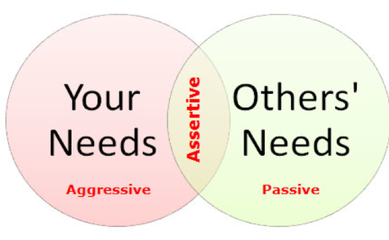
Assertiveness vs. insubordination
Insubordination
Assertiveness
Failure to follow a manager’s instruction
You can only refuse work if it’s unsafe or illegal
Document your concern about following the directive with an email, while stating your intention to follow management’s instructions
Work now, grieve later
Express concerns clearly, and with confidence. Document it.
Don’t allow yourself to be taken advantage of. File a grievance or complaint
Always remain respectful and calm
Notes:
Passiveness: i.e. avoiding, giving in, not expressing your feelings. This disrespects you, and makes you a target of bullying
Aggressiveness: i.e. put downs, yelling, and physical violence. This disrespects others, and violates the civility guidelines
Assertiveness is the appropriate middle ground between being passive and aggressive. To be assertive, you should express what you think and feel in a way that fosters mutual respect

Slide 7
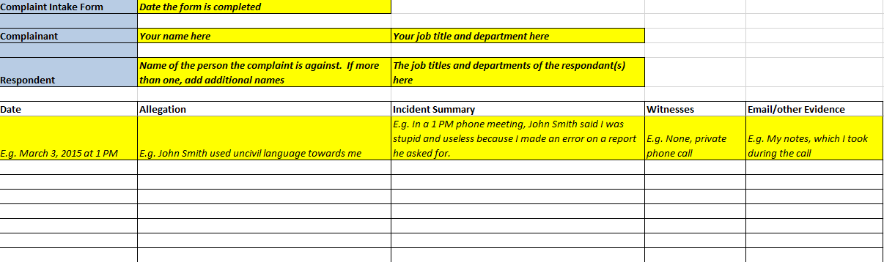
Documenting a complaint
Notes:
-The union can provide you with the Civility Complaint Intake form you can use to document a pattern of behaviour. Be sure to also document efforts you made to make the behaviour stop, i.e. discussions with the bully alerting them to how their behaviour was impacting you.
-Witnesses are the most important type of evidence, but when there are no witnesses written documentation is next most important. This can take the form of your own personal notes, however it’s better to send an email immediately after an event to the bully, notifying them their behavior was inappropriate and as discussed, you don’t want it to happen again.
-Follow up verbal instructions from you manager you feel are unreasonable with an email to document your concerns, but make it clear you will do as they say since they are the manager, you just want confirmation from them in writing re: their instructions. Even if they don’t reply, having this documentation may be critical.
-Forward important email documentation to a personal email address. Communicate with your union rep via a personal email address. Remember your utoronto email address is the property of the University and can be monitored.
-Once your union rep has reviewed your complaint and had the opportunity to make recommendations to strengthen the complaint, you can email the final version to Sean Suleman and Jessica Murray in Central HR and Workplace Investigations. Do not send your complaint to a divisional HR rep, or it may not be dealt with properly
-It is possible to file a group civility complaint. All complainants would fill out their own complaint form, and the union can then submit them together as a group complaint. Group complaints carry more weight than individual complaints. It is also harder for management to implement reprisals against group complaintants.

Slide 8

After you file a complaint
There may be an Investigation
There will be a University response
Complaint details will not be disclosed unless it’s necessary to investigate, take corrective action, or is otherwise required by law
Respondents have right to procedural fairness
You will be advised of investigation results, and any correction action taken
If a response is not received within 45 days of submitting the written complaint, you can file a grievance at Step 3
The University may determine there has been no violation, and may opt to simply respond WITHOUT conducting an investigation
Notes:
-You have responsibility to bring your complaint forward as soon as possible so it can be dealt with in a timely manner. That said, there are no set timelines with filing civility complaints like there are for filing grievances.
-If there is an investigation, you will have responsibility to provide sufficient details to allow the respondent to appropriately respond (i.e. they have to know what they are being accused of).
-A summary of allegations will be prepared by Workplace Investigations. You will be asked to review and sign it. That summary of allegations will be shared with the respondent. Your full complaint will not be shared.
-You must respect confidentiality to maintain procedural fairness and a fair working environment. However, your obligation to respect confidentiality does not restrict you from seeking union support or discussing your concerns in confidence with other support people, i.e. EFAP or Lifeline counsellors
-There is a joint civility investigation process for member on member conflict whereby the union is supposed to participate in the investigation
-Resolutions can vary greatly, depending on nature of the complaint, people involved (students, faculty, staff, contractors, etc.) and specific related policies (Student Code of Conduct, Sexual Harassment Policy, etc.)
-If complaint is substantiated, some remedial action will be taken. University may request parities participate in training, coaching, mediation or facilitation.
-There should be no reprisals for filing a complaint. Any allegation of reprisal can be filed as a grievance and will be heard at Step 2.
-There may be penalties for bringing forward complaints that are in bad faith or vexatious (i.e. without merit).
-Dissatisfaction with civility complaint outcome grievances will be heard at Step 3 of the grievance process, and if not resolved at Step 3, may be advanced to mediation or arbitration
-Although Bill 132 stipulates that complainants should be informed of any corrective action that has or will be taken as a result of the investigation, the Civility Guidelines state you may NOT be advised of the details of any sanction against any other party. This is to protect the confidentiality and privacy of the respondent, who has the right to procedural fairness.

Slide 9
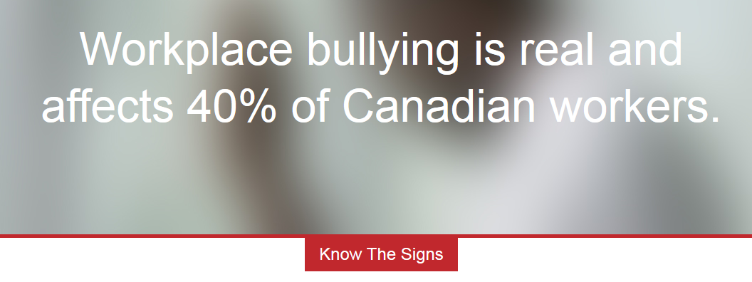



resources
Visit http://notinmyworkplace.com
Workplace Bullying Institute: http://www.workplacebullying.org/
Contact a steward or the union office for a referral
Review the civility guidelines and relevant collective agreement language
Lifeline Foundation: Call Sharon Clarke at 416-445-5819 for confidential referral services

Slide 10

Four workplace bully types
According to Dr. Gary Namie, from the Workplace Bullying Institute
Click photo to activate video

Slide 11
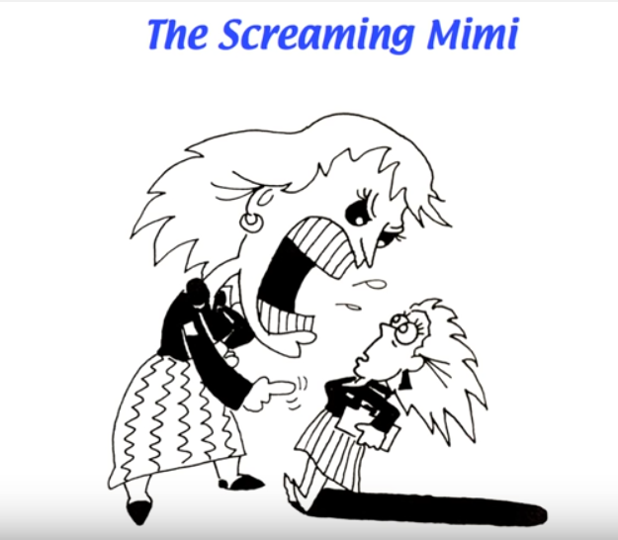
The screaming mimi
Remain calm
“You seem upset, perhaps we can talk about this later once you’ve calmed down?”
Stand up if you are sitting
Take deep breaths, don’t act defensively
Leave the area if you feel unsafe
Document the incident immediately
Notes:
-Remain calm, take deep breaths and try not to react too defensively
-If you are sitting down and the bully is standing, stand up so you are at their level
-Say calmly “You seem upset, perhaps we can talk about this later once you’ve had a chance to calm down?”
-Ask “is it ok if I record this?” Take out your cell phone to show you are serious. If the bully does not give you permission to record, say “Ok, I will just take notes then.” Take out your notepad and start writing everything they say. Include details re: witnesses, time of day, location, etc.
-Remember that you can’t record a conversation without permission. While it is technically legal to record provided at least one person in the room is aware the conversation is being recorded, from the union’s perspective we strongly advise against recording anyone without their knowledge.
-Ask if participants have other ideas/strategies for dealing with this type of bully

Slide 12
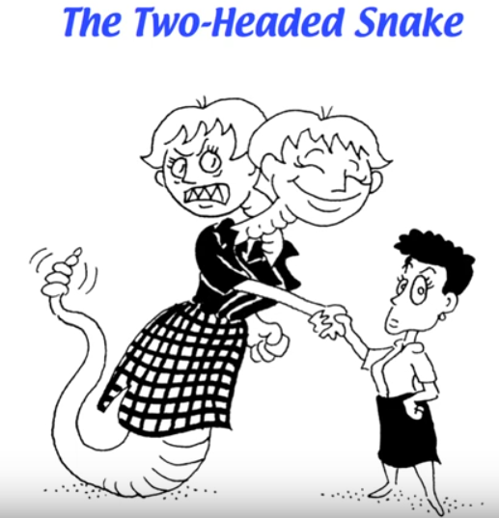
The two-headed snake
Build allies and a network of support
Don’t overshare or be too trusting
Two-headed snakes will use information against you
Try to feel compassion for the bully, understand their perspective
Notes:
-Build allies with other people in the office, whether they be colleagues (other USW members), or people with influence, such as professors, Chair, etc.
-A strong network of support can result in information sharing and added protection
-Don’t overshare with people you are not yet familiar with; don’t be too trusting. Be cautious before giving information about yourself, or revealing anything personal that could later be used against you. The Two-Headed Snake wants you to reveal vulnerabilities so they can use this information to attack you.
-Try to show and feel compassion for the bully. You don’t always know what issues they themselves might be dealing with, i.e. domestic abuse, family illness, mental illness. Allowing yourself to feel compassion for people, even when they are not compassionate towards you, allows you to calm down and diffuse. Try to look at the situation from their perspective to understand where they might be coming from.
-Ask if participants have other ideas/strategies for dealing with this type of bully

Slide 13
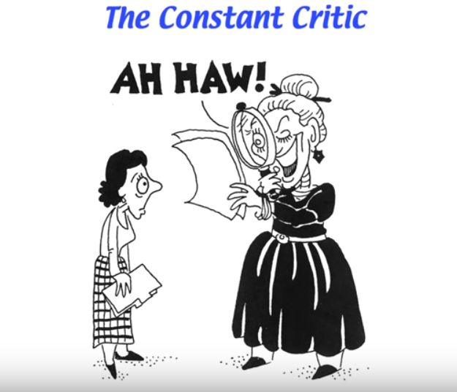
The constant critic
Never sign anything you aren’t comfortable signing, like a negative performance review
Ask to have a union rep present
“I don’t feel comfortable right now. These criticisms aren’t fair. This is not constructive feedback.”
Self care and remind yourself of your competence
Be assertive, not insubordinate
Notes:
-Don’t sign anything you’re not comfortable signing, i.e. performance appraisal.
-Ask to have a union rep present. Note that according to the collective agreement, members only have a right to union representation for disciplinary meetings, or investigation meetings that are the result of a grievance/civility complaint. Still, if you are being heavily criticized unfairly, you can ask to have a union rep present, but it will be up to manager’s discretion as to whether or not to allow it. Making the request shows you aren’t afraid to go to the union, and you understand your rights.
-You can say “I don’t feel comfortable right now, I don’t think these criticisms are fair, nor is this constructive feedback. If you would like to continue this conversation, I would like to have a union rep present.” You can get up and leave, but do so calmly and state your intention before walking out of a meeting with management without their permission. You don’t have to sit there and take it. However, you must remain calm and respectful.
-Take care of yourself. Remind yourself of your competency, of what you are good at. Don’t beat yourself up over unfair criticisms.
-Meditation/mindfulness, focusing on deep breathing, going for a walk when you are upset are examples of self-care. Learn coping skills, create an imaginary bubble to protect yourself, calm yourself.
-Use language that’s reasonable/permissible to stand up for yourself. Be assertive, not insubordinate. You have the right to stand up for your right to have a work environment free of bullying and harassment.
-Ask if participants have other ideas/strategies for dealing with this type of bully

Slide 14
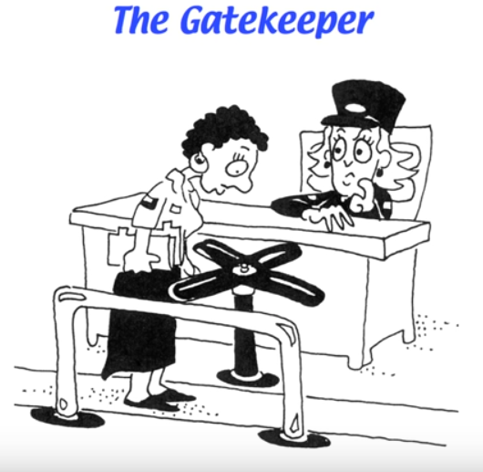
The gate keeper
An insidious form of bullying that can be difficult to deal with
Politely ask for an explanation and explain negative impact
Document in order to clearly demonstrate a pattern of behavior
Documentation is key to protect from discipline/performance management
Notes:
-This is an insidious form of bullying that can be incredibly difficult to deal with
-If a person is deliberately withholding information you require to do your job, ask them politely why; explain the negative impact this is having on you. Say you would appreciate it if they could send you the information you need to do your job. Document your attempts to resolve the problem. Follow up verbal conversations with emails to establish a paper trail.
-This is the type of situation where SIMS may not be affective, particularly if you have urgent deadlines you are being prevented from meeting. You must notify management immediately if a colleague is withholding information that may poorly reflect on your performance. Otherwise, you may be subject to performance management and discipline. Always consult the union for advice regarding your specific situation.
-Ask if participants have other ideas/strategies for dealing with this type of bully

