Slide 1
Organizational Change
What you need to know about

Slide 2
What is Organizational Change?
)
Notes:
This means that management is making changes in your department that could include new reporting structures, jobs being eliminated and/or new jobs being created either below, above or at your current payband. Either way, it means change is coming that will affect your job.
It can be something as simple as changes to the reporting structure, in which case notice of org change is not given. A formal notice of org change would only be issued if there is a potential for layoffs. The collective agreement says “budget cuts…the introduction of new technology or other factors may result in organizational change in a Department that results in the elimination of one or more positions, or the involuntary reduction of an employee’s appointment by 20% or more.”

Slide 3
How it Happens
Little notice given re: meeting
HR may be present
Rationale of org change should be provided
Org change notice cannot be issued on a Friday
Notes:
You will get called to a meeting by management and/or HR with little notice or information about the meeting. These meetings are usually 15 minutes in duration and cannot occur on a Friday. Depending on your department/faculty, HR may or may not be present.
At this meeting you will be given a template organizational change letter. You should also be provided with the operational reasons why your position is being eliminated.
After the meeting, you will have the opportunity to meet privately with a union rep.

Slide 4
Your notice of org change letter will include…
Reason(s) for organizational change
New jobs being created as a result of the Org Change?
Career Transition Services
Immediate Redeployment status
Notes:
The reasons and nature of the org change included in your actual letter are usually pretty vague, such as “in response to budget cuts”; “to realign administrative services”; “better meet the demands of stakeholder services”; or “changing goals of the unit”. More detailed information may be shared verbally. Since the University is required to inform the union of the rationale in advance of you receiving notice, the union rep you meet with after will also be able to provide you with the reasons why management has decided to eliminate your job.
2. You will have preference to any jobs created as part of the org change that are at or below your payband. If you apply, are offered, and accept one of those jobs within the six week org change notice period, you typically will not receive your 12 week lay off notice. Instead, you will start in the new job.
Be sure to contact Career Services immediately to book an appointment. Career Transition Services available include career counselling, computer skills, training support, resume preparation, and external job search support. HR can also facilitate a skills assessment upon request.
Since you will have immediate redeployment pool status, meaning you will have preference for jobs across the University at your payband or below, start applying to other jobs immediately. Make sure you clearly indicate your redeployment pool status on your applications.

Slide 5
18-Week Paid Notice Period
The first 6 weeks notice of organizational change
An additional 12 weeks of paid layoff notice
(Article 12:07b)
This Photo by Unknown Author is licensed under CC BY
Notes:
You will enter the redeployment pool immediately and you have access to Career Transition Services. If there are positions being created as a result of the org change you are eligible to apply.
If you are not successful in getting another job in the 6-week notice period, you will receive a notice of layoff. You are then entitled to an additional 12 weeks’ paid notice, before your position is eliminated. This provides for a total of 18 weeks paid notice (6 weeks for organizational change plus 12 weeks for layoff) before you are unemployed.
At the end of the 12 weeks’ notice period, you must decide between taking termination with enhanced severance, or continuing in the Redeployment Pool unpaid. If you do not make a selection, you will be deemed to have opted to remain in redeployment.

Slide 6
Your notice of layoff letter
6 weeks later
1. The date of your layoff
2. Your years of service
3. Your continued Redeployment status for the 12-week notice period
4. Your options to stay in redeployment after your layoff date or take enhanced severance
5. Information on continuing benefits after your layoff date
6. Up to seven days of paid time for training and job search
Notes:
6 weeks after receiving your org change notice, you will receive your layoff notice. Your layoff letter will detail the date of your layoff, the years of service at the university, your status in the redeployment pool, your options to stay in redeployment or take enhanced severance, and info on continuing benefits after your layoff date.
*Note* to assist you with job search or retraining, you are allowed to book off 7 paid days for job search during your 12 week layoff period. This is not usually noted in the lay off letter, but is in the collective agreement. You request the time off as you would a personal or vacation day.

Slide 7
New roles being created from the Org Change?
Are there new positions being created?
What if it’s at a higher payband?
What if no one applies to the new positions?
(Article 12:05e)
Notes:
In many cases, new jobs are created in the org change you will have the option of applying to. If a new job is at or below your pay band, you will have preferred hiring status, along with any other people losing their jobs in the org change who are at or below the pay band of the new job. If these positions are not filled by employees facing layoff, they will be posted internally to the rest of the department. If someone from your department gets one of the new positions and that creates a new vacancy in the department, this position is now open to applicants who are facing layoff. Those applicants will have preferred status if the position is at or below their pay band. Any jobs not filled by applicants with preferred status will be posted to other employees in the department before being posted university-wide.
If a new job is at a higher pay band than you are in, you can apply for the job, but you won’t have preferred status. There may be other employees losing their jobs who may have preferred status for that job. New jobs for which no one facing layoff has preferred status are posted to the entire department. The most qualified candidate is supposed to be hired.
If there are no applicants, or none are selected, the position(s) will be posted to the USW internal job board (Article 12:04)
It is a good idea to contact Career Services for interview preparation prior to being interviewed for any of the new positions. Even if you have preference, you still must demonstrate you meet the qualifications. A lot rides on your interview performance, so prepare well for it. Practice your interview skills, especially if you haven’t done one in a while.

Slide 8
Redeployment Pool
Applying to higher paybands
Redeployment preferred status
HR in the interview
Two-month window
Thinking of declining the job offer?
This Photo by Unknown Author is licensed under CC BY-SA
Notes:
When you apply to positions at higher pay bands, you must be the “most qualified” candidate. You have no preferred status.
When applying for USW U of T staff-appointed positions with preferred status, indicate in your application that you’re in the redeployment pool. You should include your redeployment status in bold at the top of your cover letter and resume.
An HR Generalist will attend job interviews if you have redeployment status. They can give you feedback afterwards upon request. Provided you demonstrate you meet the minimum qualifications and can perform the duties of the job with a one-month training and familiarization period, you should be given the job. Note that demonstrating your qualifications in the interview and any testing is essential.
If you get a new position, there is a two-month window in which you can opt to return to the pool if you are dissatisfied with the job, or management can opt to send you back to the pool if you demonstrate an inability to perform the duties. It’s like a mini probationary period. You do not have to repeat the full six-month probationary period that new U of T employees have.
If, after your layoff date, you apply for a position for which you have redeployment pool status and decline the job offer, you are deemed to have quit and are terminated. If you have a job interview and have second thoughts about taking the position, you should withdraw your application prior to receiving an offer. If you’ve already received the offer, you can take the job and exercise your option to return to the pool within the first two months.

Slide 9
Your Options
MAKING A DECSION
At the end of your 12-week layoff notice period, you must select one of two options:
1. Remain in the Redeployment Pool
2. Take Enhanced Severance and leave the university

Slide 10
Remain in the Pool
Option 1:
Finding another position at the University
Timing: redeployment pool and Career Transition Services
Accepting term positions of 1 year or less
Accepting term positions greater than 1 year
Notes:
You will have up to 24 months of unpaid redeployment pool status from your date of layoff and 6 additional months of career transition services. During this time, you can apply for EI, and register with UTEMP to pick up casual gigs until something better comes along.
You continue to apply for jobs with redeployment preference for positions at your pay band or lower. If you accept a position of one year or less, your redeployment clock will be stopped while in the term position. Four weeks before the end of the term, your redeployment clock will restart where it left off. At the end of the term, if you choose to go back into the pool, you will resume the remainder of your pool time.
If you accept a term position of greater than one year, you will receive a new notice of layoff 12 weeks before the end of the term. This will replenish your redeployment pool time back to 24 months.

Slide 11
Remain in the Pool (contd…)
Option 1: `
Can I opt out of the redeployment pool at anytime?
What about my benefits?
Do I still qualify for tuition waiver benefits?
What happens to my vacation?
Notes:
4. You can opt out of the pool and take your remaining severance (regular not enhanced) at any time. The amount you receive reduces the longer you’ve been in pool, at 6 months,12 months and 12+ months. These amounts will be spelled out in your layoff letter. See also Schedule I, Severance Pay in the CBA (and slide 13).
5. Benefits
If you remain in redeployment, you can continue coverage for some or all of your health care benefits for up to 6 months provided you pre-pay the employee premiums. The University will continue to pay the employer portion. If you are in a financial position to do so, you should consider continuing your pension. The amount of the University’s pension premiums over six months may be worth more than the difference between enhanced severance and the reduced severance you would receive after remaining in redeployment for six months. You can calculate this by logging on to ESS to review benefit costs.
After the first 6 months in redeployment, you can continue benefits for an additional 9 months but will have to pre-pay both the employee and employer premiums.
If you take enhanced severance, you can only continue some benefits (not pension) provided you pay both the employer and employee premiums
If you take severance, you can’t work at the University again throughout the duration of your severance period, i.e. if your severance is equivalent to 30 weeks of pay, you can’t work at the University again for 30 weeks. This includes casual employment.
While in redeployment, you can work at jobs external to the University, or as a casual through UTEMP.
You can continue to qualify for the tuition fee waiver for dependents and educational assistance provisions, including School of Continuing Studies.
Vacation does not accrue after your layoff date. Your department may pay out your vacation, or you may be able to keep it banked. There is no consistency across the University. You should reach out to HR if you have a strong preference. There is also a chance there might be some vacation clawback in accordance with Article 22:09. We are currently disputing this practice through a policy grievance. Ask HR to clarify if your vacation payout will be reduced.

Slide 12
Taking the Severance Package
Article 12:10a; Schedule "I"
Option 2:
Enhanced severance vs Regular Severance
Career Transition Services
Can I apply to the University again?
Notes:
Members who decide to immediately cease employment with the university effective their lay off date will receive the enhanced severance package. Those who decide to initially remain in redeployment can opt for termination at any time, at which point they will receive the regular severance package. This amount depends on your years of service and the amount of time you remain in redeployment. Please refer to the severance schedule (Schedule I in the CBA/next slide).
You can request that a portion of your severance is paid directly into a tax-protected RRSP (note you must have sufficient RRSP contribution room). Sometimes, if you are laid off near the end of the year, HR will agree to pay your severance out in two separate installments so they fall during different tax years, thus reducing the overall tax you will pay on the lump sum. Note that this is extremely rare; while you can ask, don’t expect HR to agree
You can use career transition services for up to 3 months after your lay off date.
You cannot re-apply to a position at the university until your weeks of severance have passed (ie: if you receive 10 week’s severance pay, you must wait 10 weeks before applying to other jobs at the university as an external candidate)

Slide 13
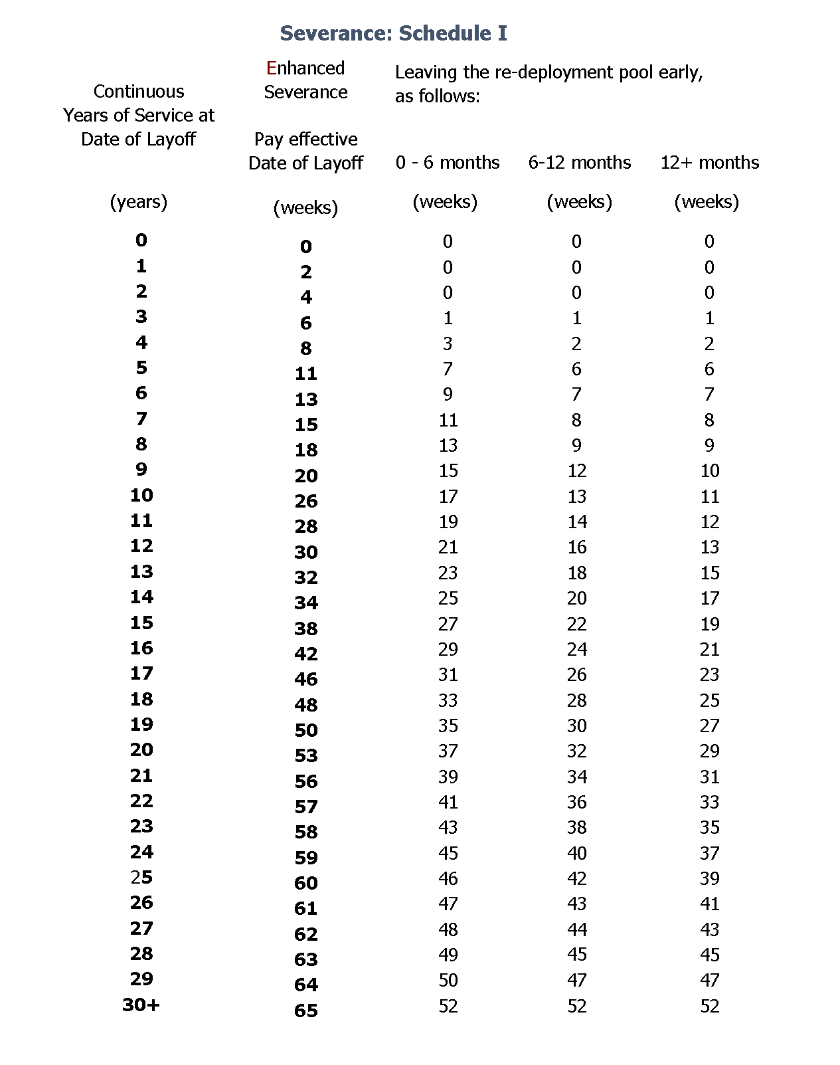
SEVERANCE SCHEDULE

Slide 14
More on Benefits
How long can I continue with U of T benefits?
What happens if I take the enhanced severance package?
Notes:
After the first six months in redeployment, you can continue benefits for an additional 9 months but will be responsible for paying both the employee and employer premiums.
If you take enhanced severance, you can only continue some benefits (not pension) provided you pay both the employer and employee premiums.

Slide 15
Early Retirement
Am I eligible for early retirement?
What are Grow-in rights?
Notes:
1. Members who are eligible for early retirement If you are eligible for unreduced early retirement before your layoff date, you can choose to terminate your employment with the University, take your enhanced severance, and retire with an unreduced pension and receive the Early Retirement Bridge Benefit . (NOTE: the Early Retirement Bridge Benefit is only available to members who take unreduced early retirement between December 31, 2020 and April 30, 2021. We need to bargain the next bridge into our next CBA.)
2. The big picture is that grow-in rights protect older workers from being penalized for being laid-off before their early retirement date. This doesn’t mean that there’s no penalty at all. It means that the penalty comes in from age 60, not age 65. In a non-lay-off situation, if someone doesn’t qualify for the 60/80 factor and wants to retire early, there is a 5% per year reduction for every year before their normal retirement date (age 65). So, if you wanted to retire at 55, the reduction to your pension would be 50% (5% a year for the years from 55 – 65).
In a lay-off situation grow-in rights mitigates this by dropping the penalty to age 60. So if you are 55 at the time of lay off, your pension would only be reduced by 25% instead of 50%. So, it’s not a case of no penalty. It’s less of a penalty. The laid-off person would have two options:
a. Laid off at age 58 – wants to take the enhanced severance, retire from active service and get the health benefits – they would get credit for their years of service, but the pension would be reduced 10% (5% a year from age 58 to 60).
b. Laid off at age 58 – wants to take the enhanced severance but doesn’t want the pension reduction and doesn’t need retiree health benefits. In this case, provided they are willing to wait two years, they can get the full pension at age 60.

Slide 16
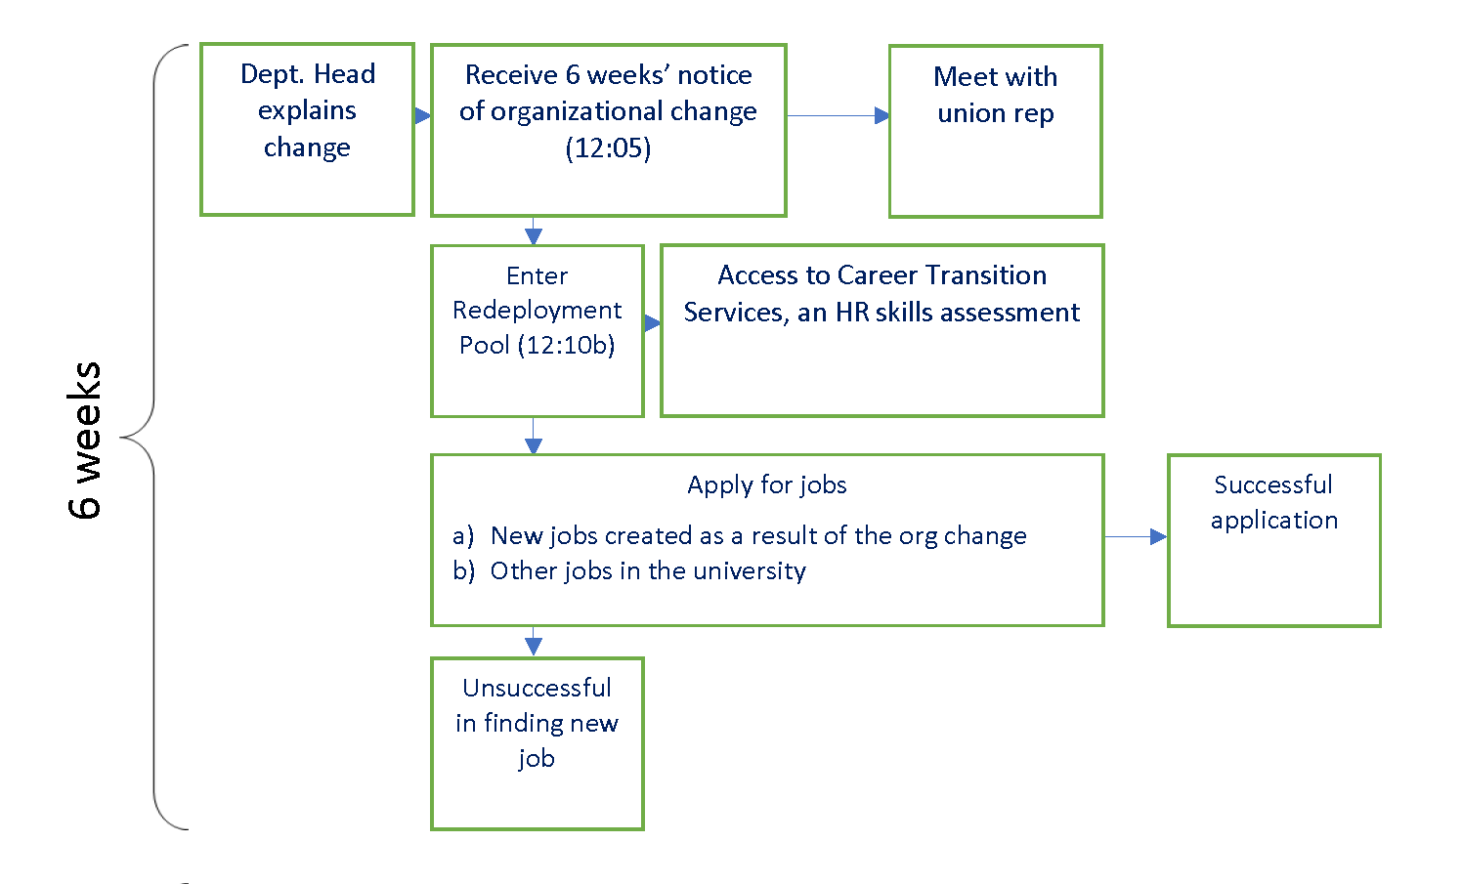
Organizational Change Flow Chart
First 6 weeks
Notice or Organizational Change

Slide 17
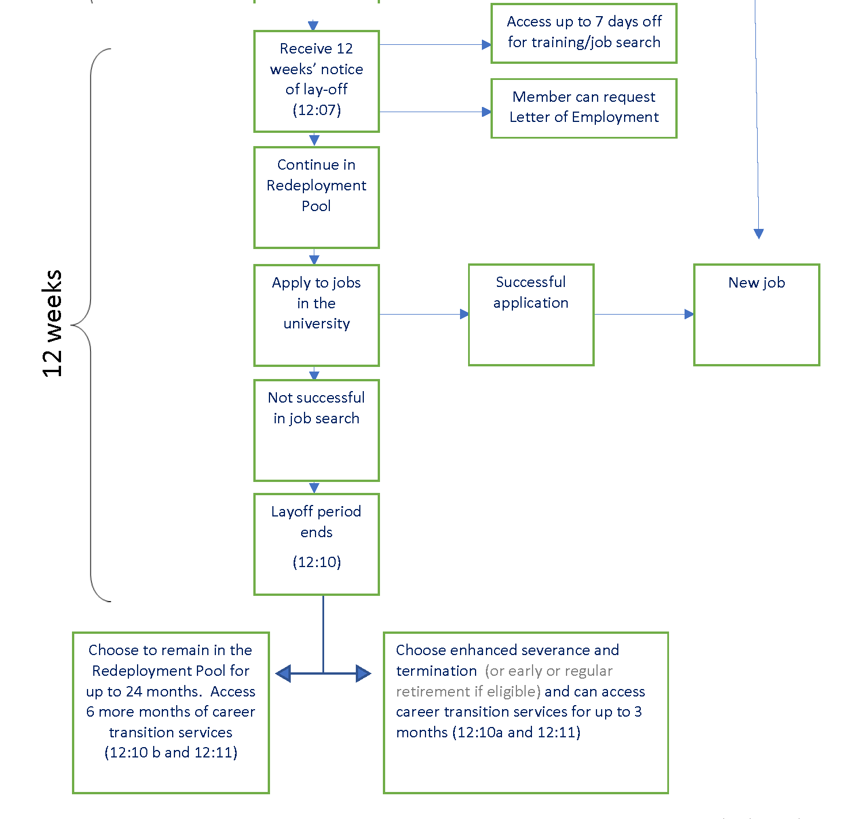
Org Change Flow Chart
Next 12 weeks
Working notice of the elimination of your position

Slide 18
Grievance?
When should you file an improper Org Change Grievance?
If there is evidence the work is being contracted out
If the org change and lay off procedures in the CBA are not followed
If the circumstances justifying the lay off changes
Notes:
-Org change grievances are very hard; we can’t file a grievance just because you don’t agree with management’s decision, or the rationale. Management has the right to make stupid decisions
-That said, there is a process management must follow to eliminate a position, as outlined in our contract. If they don’t follow that process, there may be grounds for a grievance
-If there is evidence the work is being contracted out, or going to casuals, there may be grounds for a grievance
-An example of changed circumstances would be if the lay off was the result of government funding cuts, but half-way through your notice period, those funding cuts get reversed but management refuses to rescind the lay off notice. Or if management claims a grant that funds a position is ending, but then it gets renewed.
-Failure to Hire or Failure to Interview grievances can be filed if a redeployment candidate is not invited to an interview or hired for a job they have applied to, where they have demonstrated they meet the minimum qualifications. This presumes you have redeployment pool status for the position in question (it’s at your pre-lay off payband or below).

Slide 19
Other Supports
1. Lifeline Foundation
Coordinator: Sharon Clarke
416-977-6888 life_line@bellnet.ca
U of T’s Employee & Family Assistance Program (EFAP)
1-800-663-1142 http://benefits.hrandequity.utoronto.ca/efap/
Career Services U of T
https://ulearn.utoronto.ca/career-services/
Job loss, marital or family concerns, alcohol or drug use, depression, stress, anxiety, financial problems, legal Issues and violence Issues.
Notes:
Lifeline Foundation
Lifeline provides free, confidential counselling, information and referral services to Steelworker members and their families on a variety of issues: job loss, family issues, alcohol or drug use, depression, stress, anxiety, financial problems, legal issues and violence issues
2. The EFAP is operated by an external provider, Homewood Health. It is available 24 hours, seven days a week, 365 days a year.
3. Career Services provides a variety of resources to assist with navigating your job search, for example reviewing and making recommended improvements to your resume and cover letter and practice interviews.

Slide 20
THANKS!
Any questions?
You can contact us at
info@usw1998.ca
416-506-9090

